Slide 1
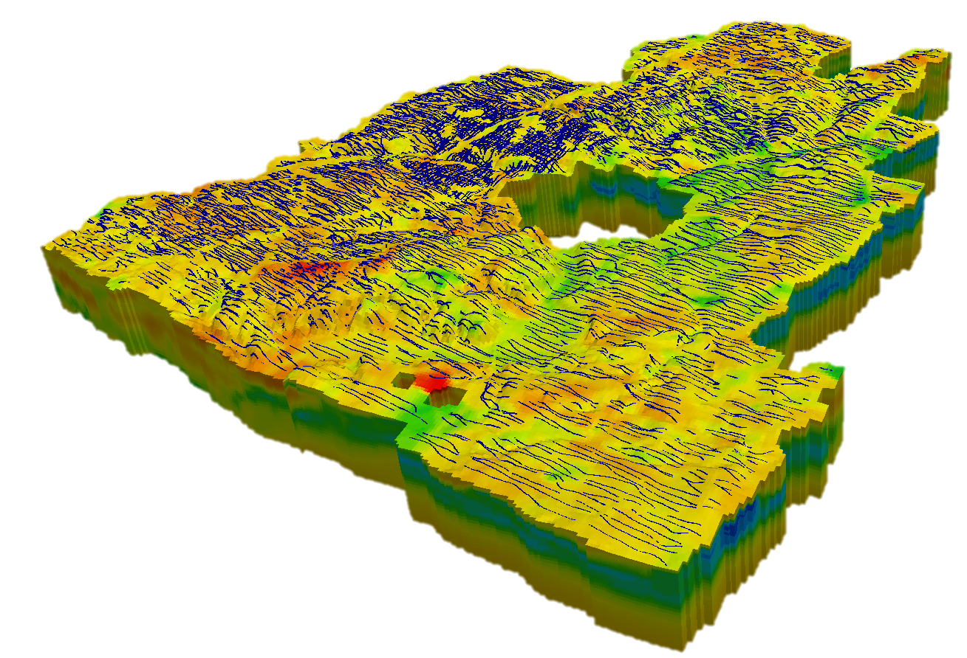
Comparing AEM with lithological data using a comprehensive database system for geological and downhole geophysical information
Esben Auken, Professor
HydroGeophysics Group, Aarhus University, Denmark

Slide 2
Co-workers
Cyril Schamper, Paris IV University, France
Flemming Jørgensen, GEUS
Ingelise Mølller Balling, GEUS
Flemming Effersø, SkyTEM Surveys Aps
Kurt Sørensen, SkyTEM Surveys Aps and Aarhus University
Casper Kirkegaard, HydroGeophysics Group, Aarhus University
Anders V. Christiansen, HydroGeophysics Group, Aarhus University
(GEUS – Geological Survey of Denmark and Greenland)

Slide 3
Outline
GERDA and Jupiter – data management system on corporate and nation level
Borehole logs as a prof of resolution for new AEM system

Slide 4
Why bother about databases?
Database – datamodel – ensuring data consistency
Web based access or direct client access
SQL for resorting and querying data

Slide 5
GERDA – Geophysical Data
Oracle or Firebird on corporate level
Microsoft Access on client level
GERDA
Raw data
Processed data
Models
Meta data

Slide 6
GERDA – Geophysical Data
Established 1998
+50 000 groundbased TEM soundings
+40 000 line km SkyTEM
+10 000 km ERT
+200 geophysical logs
+5000 VES soundings
?? Km HEM and GCM
1D layered models
2D models
Geo reference data
GERDA
Raw data
Processed data
Models
Meta data

Slide 7
GERDA + Jupiter – Geophysical Data
Archive established 1926
+280 000 boreholes
Data quality is varying
GERDA
Jupiter
Raw data
Lithology
Processed data
Pressure head
Models
Geochemistry
Meta data
Meta data

Slide 8
GERDA + Jupiter – Geophysical Data
Data access from www and
modelling programs
GERDA
Jupiter
Raw data
Lithology
Processed data
Pressure head
Models
Geochemistry
Meta data
Meta data

Slide 9
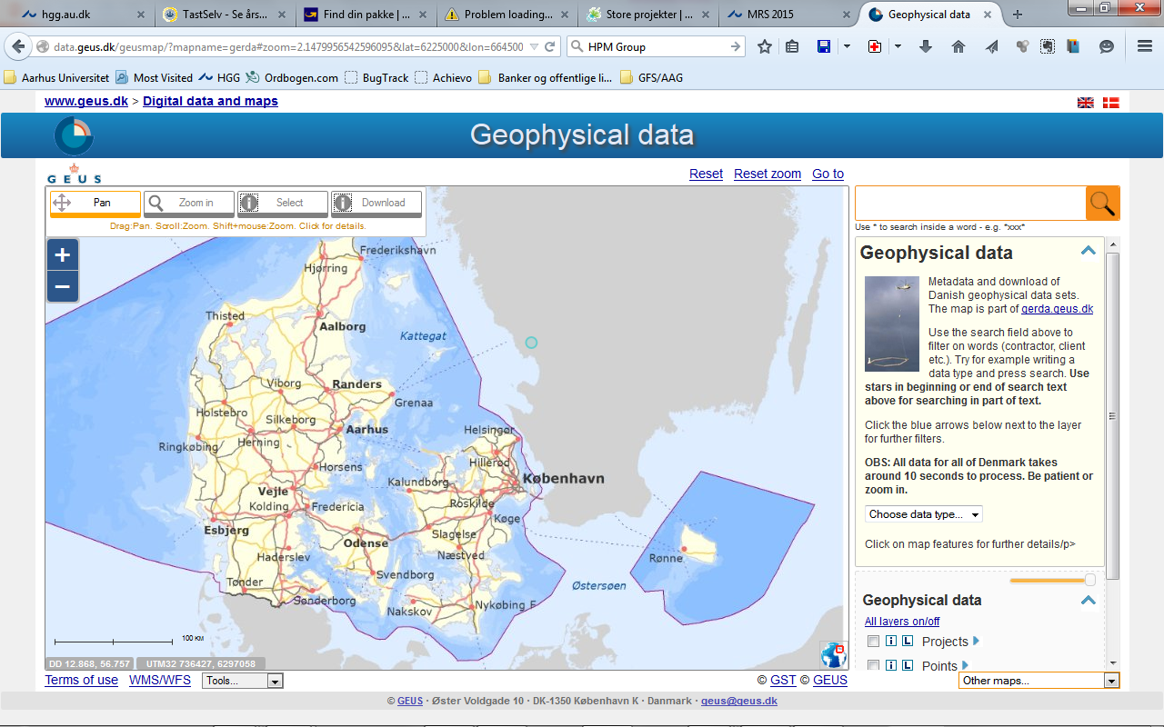

Slide 10
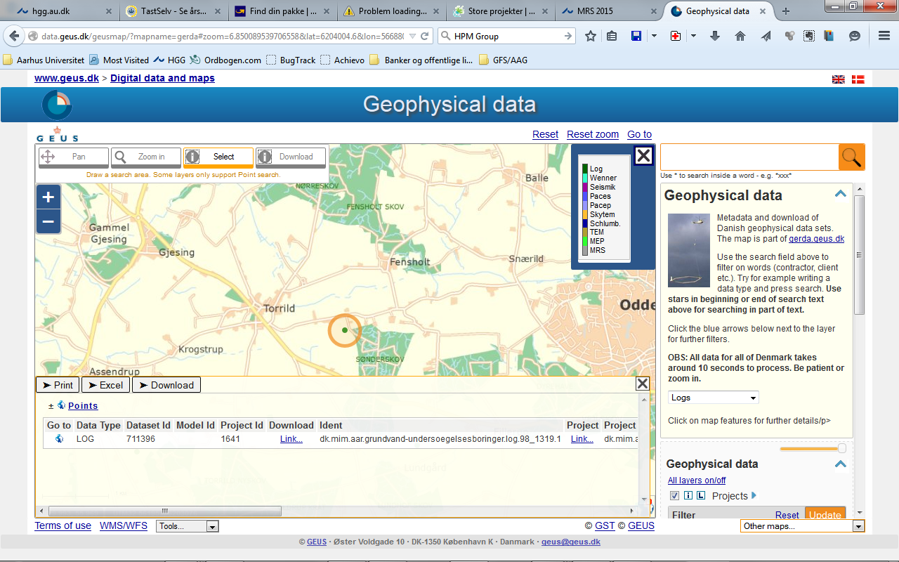

Slide 13
Why bothering about databases?
Database – datamodel – ensuring data consistency
Web based access or direct client access
SQL for resorting and querying data
GERDA is a well structured data georeferenced exchange format
Data is added by contractors and extracted by clients
Møller, I., Søndergaard, V.H. ,Jørgensen, F., Auken, E, & Christiansen, A.V, 2009
Integrated management and utilisation of hydrogeophysical data on a national scale. Near Surface Geophysics, 7, 647-659.

Slide 14
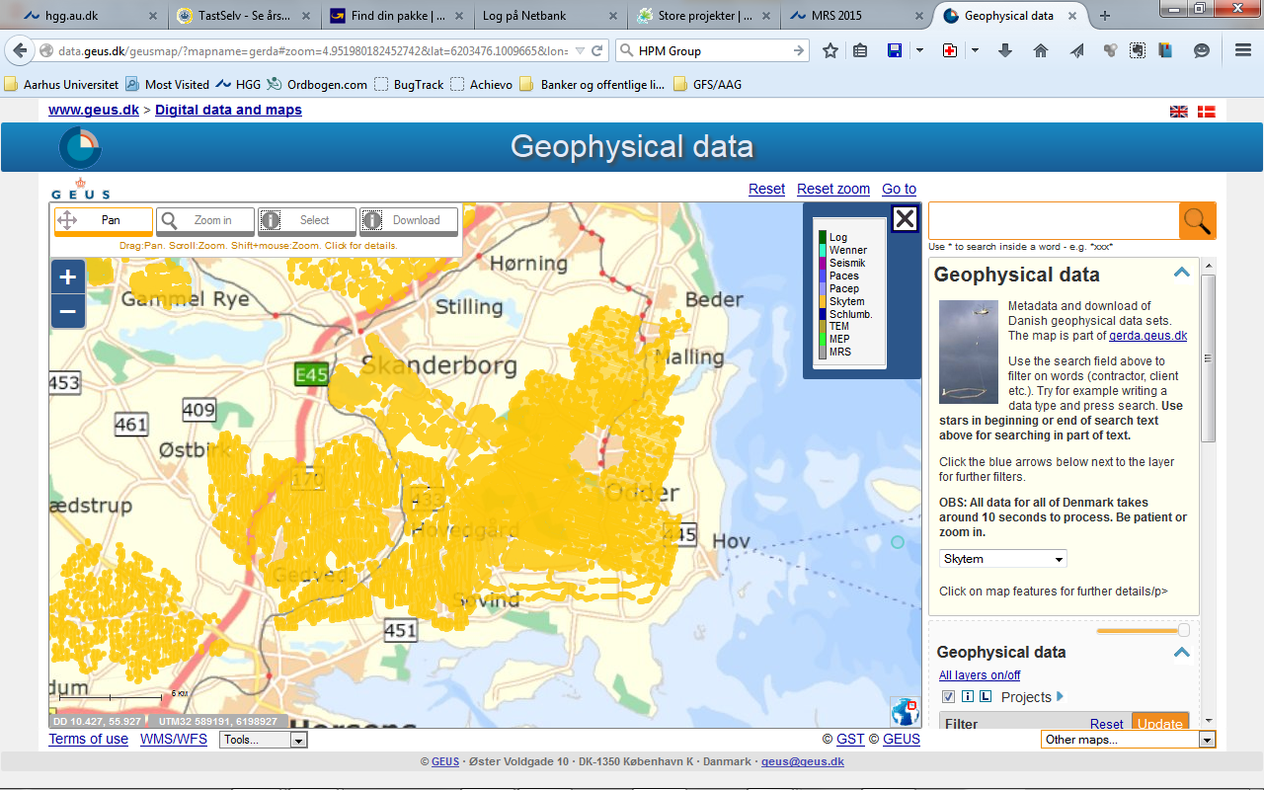
SkyTEM data

Slide 15
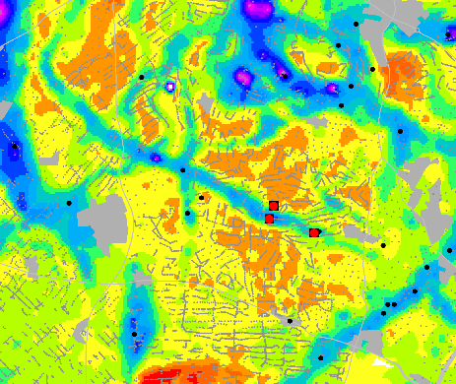
Aarhus Workbench
AARHUS WORKBENCH
DATABASE
GIS

Slide 16
Aarhus Workbench
AARHUS WORKBENCH
DATABASE
GIS
DATA
IMPORT
TEM
ERT/IP
ATEM
XYZ files
Models
GCM
HEM

Slide 17
Aarhus Workbench
AARHUS WORKBENCH
DATABASE
GIS
DATA
IMPORT
DATA PROCESSING
TEM
ERT/IP
ATEM
XYZ files
ATEM
ERT/IP
Models
GCM
GCM
HEM

Slide 18
Aarhus Workbench
AARHUS WORKBENCH
DATABASE
GIS
DATA
IMPORT
DATA PROCESSING
DATA
INVERSION
TEM
ERT/IP
ERT/IP
ATEM
XYZ files
ATEM
ERT/IP
ATEM
Models
GCM
GCM
HEM
GCM
HEM

Slide 19
Aarhus Workbench
AARHUS WORKBENCH
DATABASE
GIS
DATA
IMPORT
DATA PROCESSING
DATA
INVERSION
THEMES & PROFILES
TEM
ERT/IP
ERT/IP
ATEM
XYZ files
ATEM
ERT/IP
ATEM
Models
GCM
GCM
HEM
GCM
HEM

Slide 20
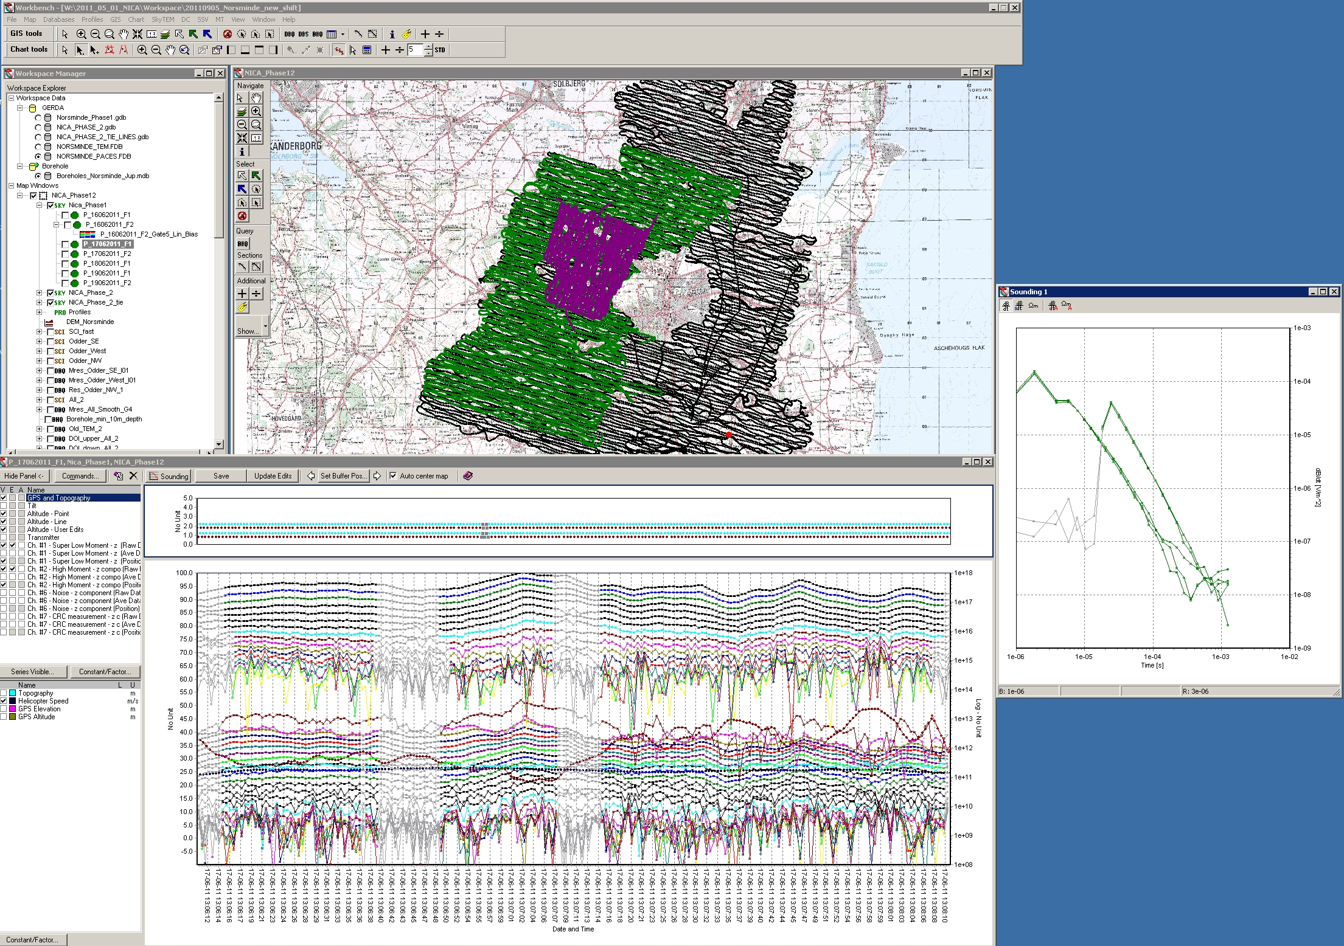
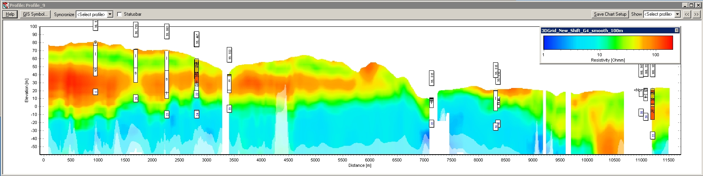
Aarhus Workbench

Slide 21
Outline
GERDA and Jupiter – efficient data management system on corporate and nation level
Borehole logs as a prof of resolution for new AEM system

Slide 22
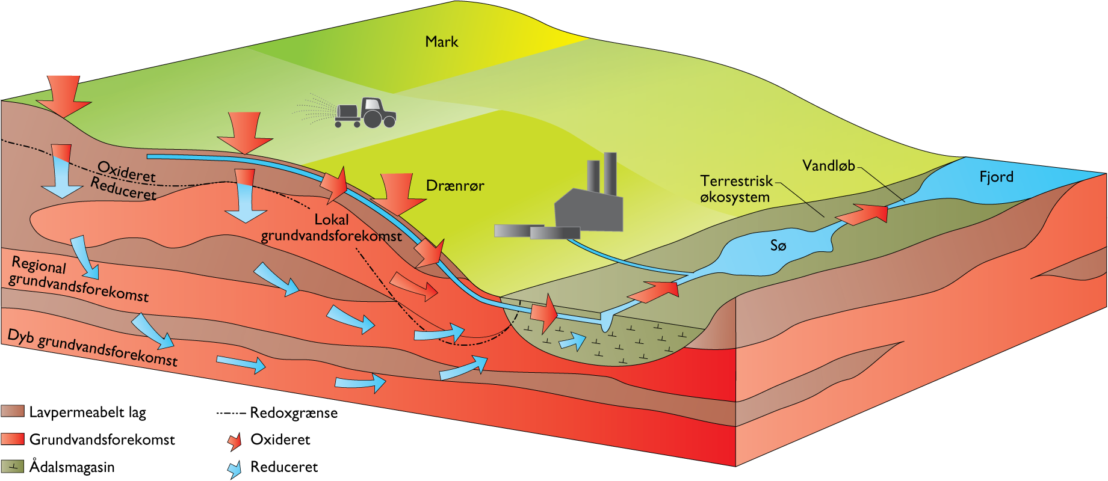
Nitrate reduction in geologically heterogeneous catchments
Information about the upper 20m critical
Refsgaard, et al.,2014,
Nitrate reduction in geologically heterogeneous catchments - A framework for assessing the scale of predictive capability of hydrological models
ScienceDirect, 468-469, 1278-1288.

Slide 23
Area and flight lines
100 m line spacing
13 hours - 1203 km
25 m line spacing
2 hours - 178 km
50 m line spacing
5 hours - 465 km
…1846 km in 1 week
(Aarhus->Barcelona)

Slide 24
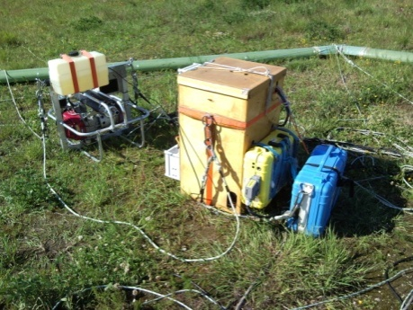
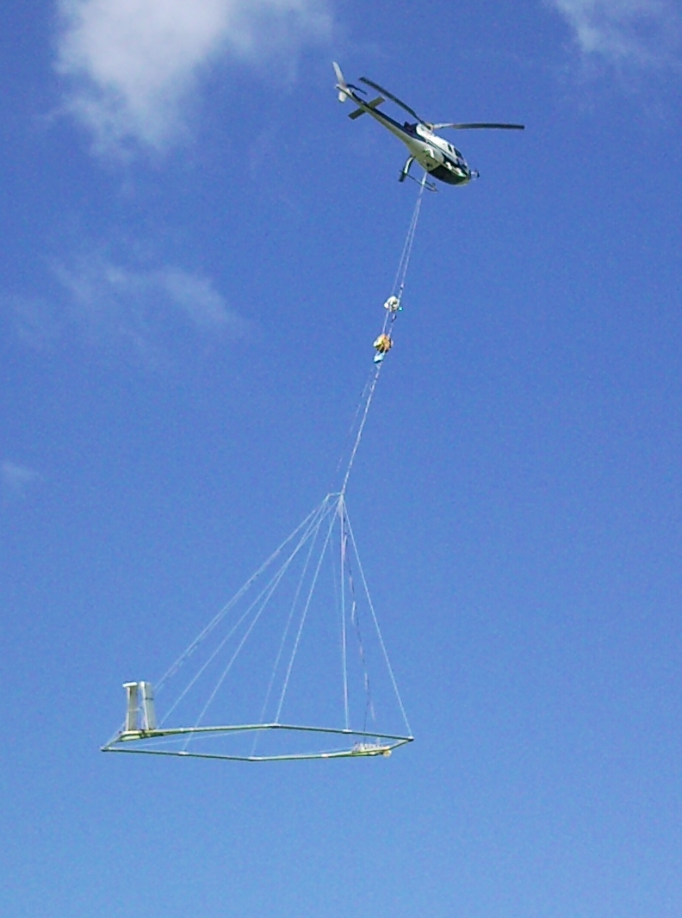
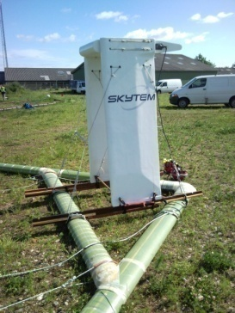
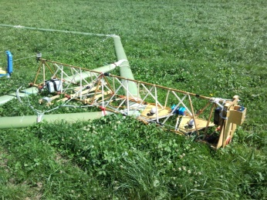
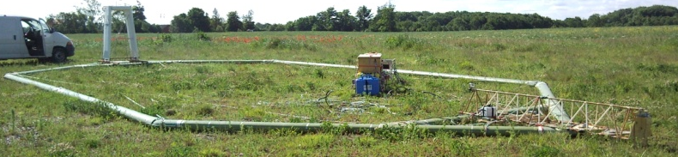
SkyTEM 101
Turn-off time low moment ~4 µs
First gate ~5-6 µs; ~1-2 µs after turn-off
LM measured every 0.6 s (~ 80 stacks)
Lateral resolution 15 m
Loop area ~130 m²
Speed +100 km/h
Nominal flight altitude: 30 m
Generator
Instruments
Receive coil
GPS,
Tilt
Lasers
Transmitter loop

Slide 25
Dual moment deep and near surface investigation
2 decays in time - 5 decays in signal
High Moment (HM)
1e-05
Near surface information
dB/dt [V/m^2]
1e-06
Deep information
Low Moment (LM)
1e-07
1e-08
Noise
1e-09
1e-06
1e-05
1e-04
1e-03
1e-02
1e-01
Time [s]

Slide 26
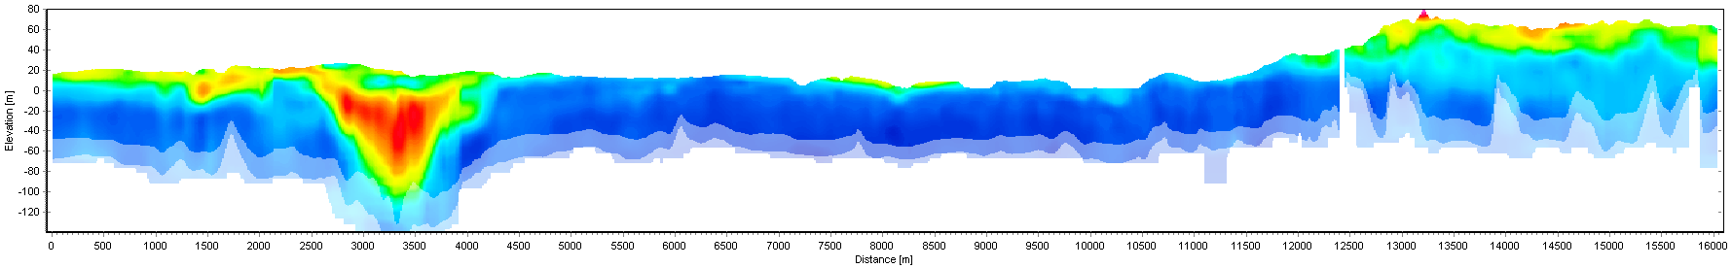
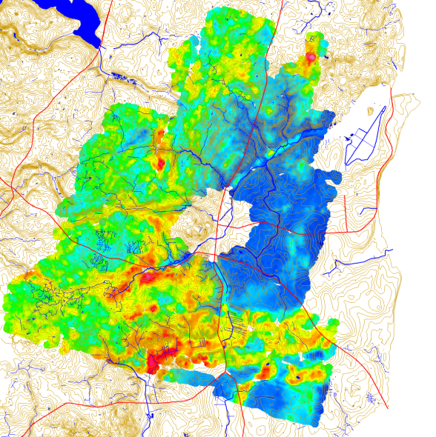

Profile South-North
Clay lenses
Glacial valley
Palaeogene clay
Sand layers
S
N
Glaciotectonic
complex
(Smooth SCI with 29 layers + 3D gridding)
Sand
0.1
1
10
100
1000
Clay
Resistivity (Ωm)
Mean resisitvity map 15-20 m

Slide 28
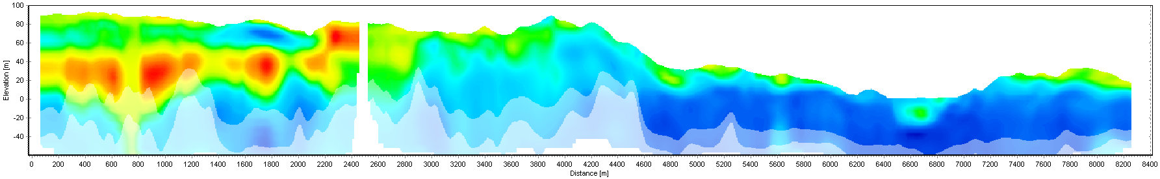

Profile West-East: the very near surface
Small buried valley
W
E
Glaciotectonic complex
Sand layer of 5-10 m
(Smooth SCI with 29 layers + 3D gridding)
Clayey lens
Sand
0.1
1
10
100
1000
Clay
Resistivity (Ωm)

Slide 29
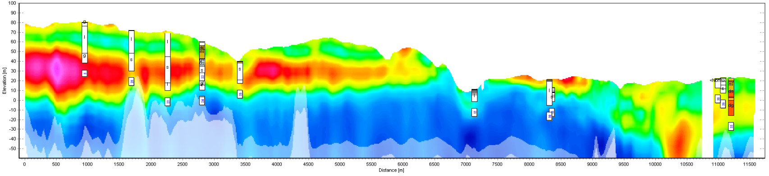
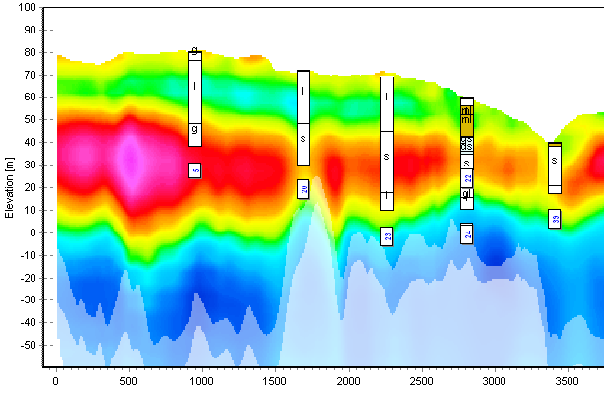
SkyTEM 101 versus lithological logs
W
E
I = clay
ml = moraine clay
s = sand
ds = glacial sand
g = gravel
Sand
0.1
1
10
100
1000
Clay
Resistivity (Ωm)
(Smooth SCI with 29 layers + 3D gridding)

Slide 30
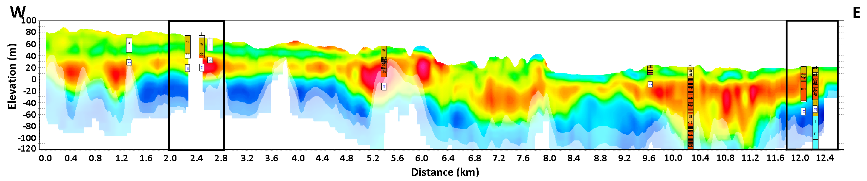
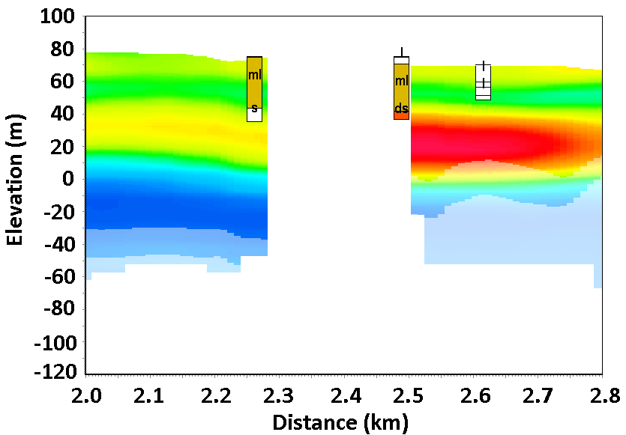
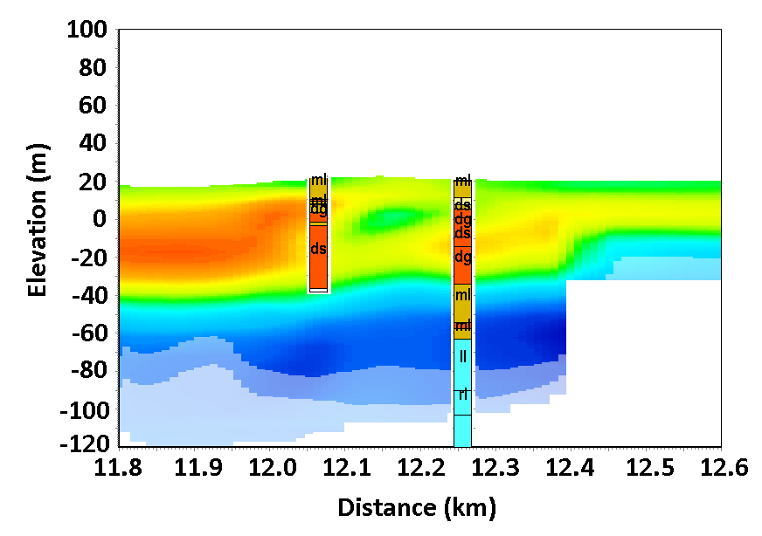
SkyTEM 101 versus lithological logs
I = clay
ml = moraine clay
s = sand
ds = glacial sand
g = gravel
Sand
0.1
1
10
100
1000
Clay
Resistivity (Ωm)
(Smooth SCI with 29 layers + 3D gridding)

Slide 32
SkyTEM 101 versus lithological logs
Final statistics (46 boreholes < 15 m from SkyTEM soundings)
44 % with very good match
33 % with good match
17 % with poor match
6 % which disagrees
Reasons of mismatches (poor and disagrees – 23%)
  Borehole data, quality of samples and descriptions/geological interpretations (37 %)
  Vertical geological variations, vertical resolution (23 %)
  Lateral geological variations, horizontal resolution (17 %)
  Borehole coordinates (13 %)
  Other/unknown (10 %)
Schamper, C., Jørgensen, F., Auken, E., and Effersø, F.,2014,
Assessment of near-surface mapping capabilities by airborne transient electromagnetic data - An extensive comparison to conventional borehole data
Geophysics, 79, B187-B199

Slide 33
Conclusion
Databases ensures data consistency
Data are georeferenced and meta data are stored in well described format
Data exchange on the internet from contractors to clients
SkyTEM 101 versus lithological logs show excellent correlation

Slide 34
Thank you for your attention

